Slide 1
OBI in eagle-i
Carlo Torniai, Melissa Haendel
Oregon Health & Science University
2011 ICBO tutorial
Notes:
Notes - What is eagle-i
- Application ontology
- why we used OBI
- Usage of instrument
- collaborative effort on Excel
- aligning instrument representation across NIF and eagle-i for data consistency and interoperability
- Mention QTT
- Service representation
- OBI: design pattern
- how we have mapped this in
Focus on if you need to start form scratch OBI is a good place
- it can "easily" be extended according to your needs
- ensure compliance with standards

Slide 2


Outline
Goal: Leverage OBI to develop an interoperable application ontology for representing research resources
About eagle-i:
Project background
Ontology requirements
Use cases:
Instrument
Services
c o n s o r t i u m

Slide 3
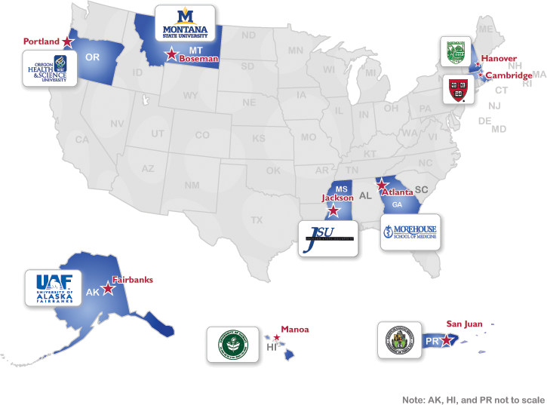
eagle-i
NIH funded pilot project working to make scientific resources more visible via a federated network of nine institutional repositories
Index invisible resources
reagents, protocols, techniques, instruments, expertise, organisms, software, training opportunities, human studies, biological specimens, etc.
Make data available using ontology-driven approach to research resource annotation and discovery
c o n s o r t i u m
Notes:
Took out 2-yr. research. Mention genes, genotypes, sites of action etc. on point 2.

Slide 4
eagle-i ontology: development drivers
Represent collected resource information
Use the ontology to control the data collection and search applications user-interface (UI) and logic
Build a set of ontologies that are reusable and interoperable with other ontologies and existing efforts for representing biomedical entities.
c o n s o r t i u m
Notes:
Follow OBO Foundry orthogonality principle
Best practices for biomedical ontology development
Engage in discussions within the bio-ontology and resource discovery community (alignment with similar efforts NIF, BRO, VIVO)

Slide 5
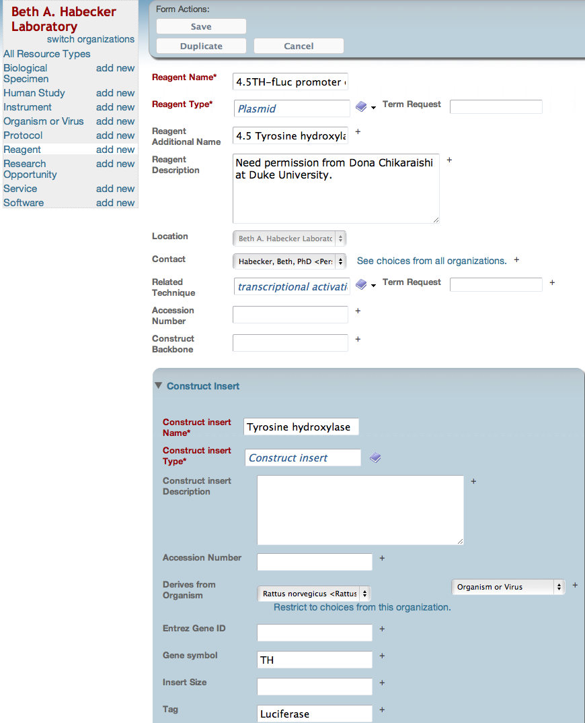
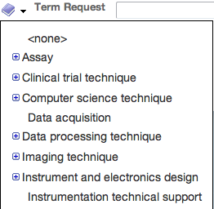
Notes:
Application specific annotation in actions: Shown is an example of a ‘plasmid’ record annotated using the eagle-i ontology. (1) eagle-i classes annotated with the “resource root” value are displayed in the left bar menu. (2) The value of ‘eagle-i preferred definition’ is used for tooltips that appear while hovering over the property labels. (3) The ‘eagle-i preferred label’ is used for the display name of property. Here, the imported RO ‘location_of’ has been renamed "Location". This property is also flagged as a primary property using the ‘inPropertyGroup’ annotation property, as are ‘Additional Name’, ‘Description’ and ‘Contact Person’ properties. This flag results in presentation at the top of the property list for a record. (4) Users can select a technique associated with the reagent. In the ontology, the ‘technique’ class is annotated as a ‘referenced class’ which tells the UI to allow reference to an ontology term but create no instances. (5) Construct insert is an example of a resource annotated as an ‘embedded class’, which has to be created in the context of a construct or plasmid of which they are a part.

Slide 6
Why OBI?
Don’t reinvent the wheel
A lot of overlap between eagle-i and OBI content
OBI and eagle-i follow common design principles:
Same upper ontology Basic Formal Ontology (BFO)
OBO Foundry orthogonality
Ease of reuse and imports
OBI is an integrative ontology connecting many domains: maximize the interoperability
Good support from a community of developers
c o n s o r t i u m

Slide 7
How we used OBI
MIREOTed a set of terms and properties:
Classes: Techniques (aka planned processes), roles, functions
Properties: has_specified_input, has_specified_output
Two use cases of new OBI related development:
Instruments: reused existing classes and contributed new ones
Services: collaborate to define new modeling
c o n s o r t i u m

Slide 8
Use case 1: Instruments
Goals
Reuse classes already defined as OBI ‘device’
Use the same OBI design pattern for eagle-i instrument classes
Define equivalent classes based on device functions
Eg: measurement device
Equivalent to: device and (has_function some 'measure function')
Align instrument representation with other similar efforts (NIF, RDS, VIVO)
Contribute back, enriching OBI devices
c o n s o r t i u m

Slide 9
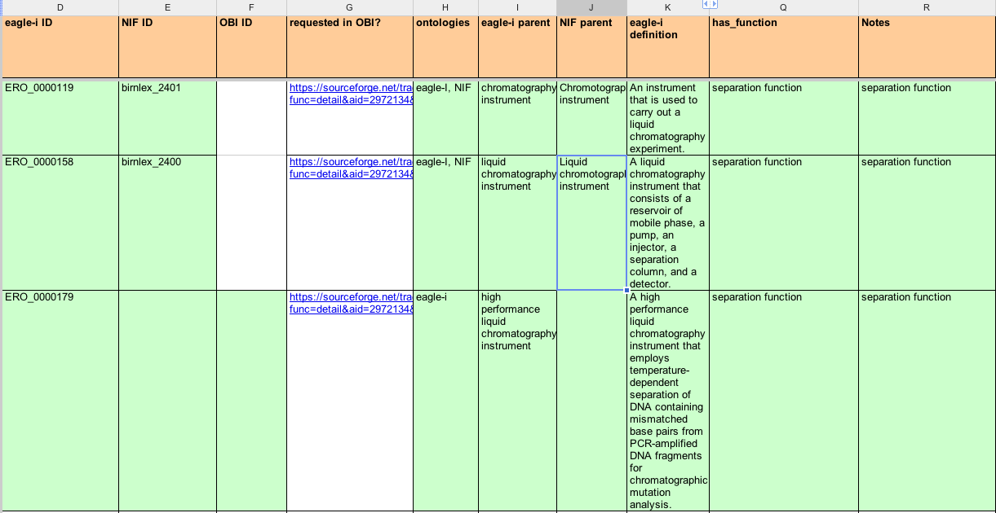
Instruments: implementation
1) Align eagle-i instruments with OBI devices
2) MIREOT the device classes already present in OBI (eg. DNA sequencer, centrifuge)
c o n s o r t i u m
Notes:
Here say that we actually created our own instrument calss because

Slide 10
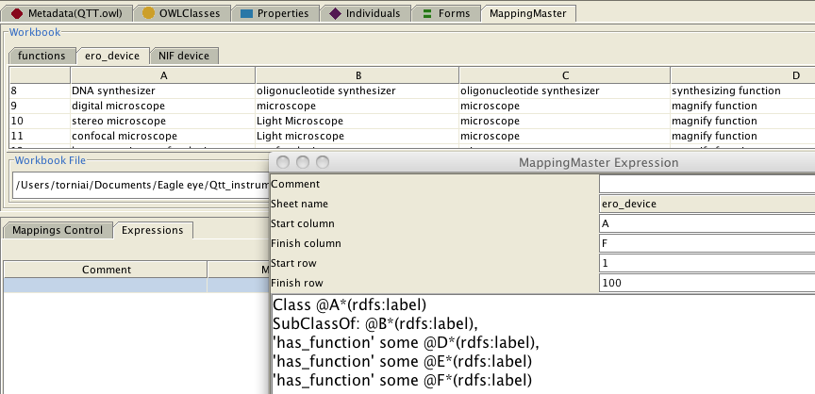
Instruments: implementation
3) Generate new instrument to be implemented in OBI using Quick Term Template (QTT)
4) MIREOT back from OBI the new instrument classes into eagle-i
c o n s o r t i u m
Notes:
Here I may want to need

Slide 11
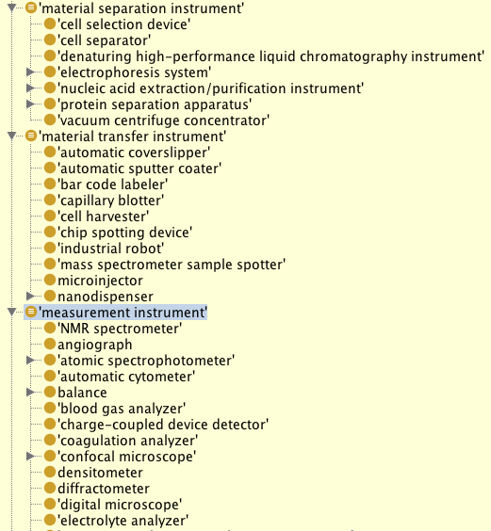
Instruments: implementation
Instrument hierarchy enables search across multiple axes
c o n s o r t i u m

Slide 12
Instruments: Advantages
Reusing already defined devices in OBI
Definitions and metadata already available and vetted by the community
Aligned instrument representations across other similar efforts
Same URIs facilitate data integration and interoperability
Adoption of OBI design pattern
Functional hierarchy for eagle-i instrument
Contribution to OBI development
c o n s o r t i u m
Notes:
Maybe I will have just the slides with the figures

Slide 13
Use case 2: Services
Goals:
Define a common representation of services across eagle-i, NIF, OBI
eagle-i requirements:
Collect metadata about services
Cost, restrictions, etc.
Align with high level services categories used by other efforts
c o n s o r t i u m
Notes:
Set of Nif sevices: Material access Service ,

Slide 14
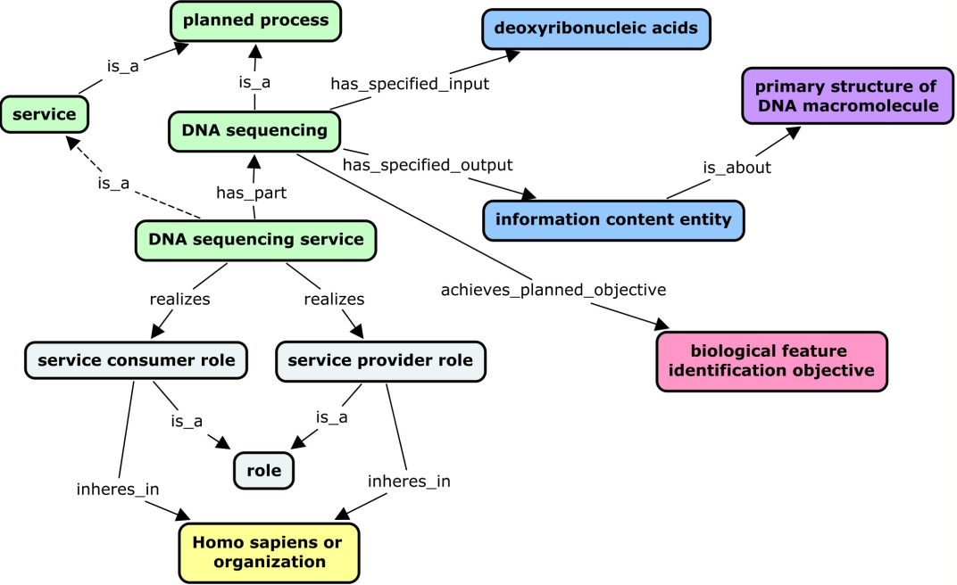
Services: implementation
Contribute to define the following design pattern during 2011 OBI Workshop
c o n s o r t i u m
Notes:
Services are typically offered by core laboratories, which perform some planned process (for example, an assay or a material production) for a customer. Like planned processes, services are also linked to entities such as protocols, instruments, specimens, reagents, and objectives. However, key features that distinguish services from the planned processes they perform are the additional processes entailed in a service (order placement, billing, etc.). In addition, services necessarily have service providers and service consumers as participants. To capture these distinctions and allow query using these search facets, a design pattern was used in which a service has_part some planned process and realizes some ‘service consumer role’ and ‘service provider role’ which inheres_in a person or organization.

Slide 15
Services: hierarchy
Service hierarchy defined according to process input and output
c o n s o r t i u m
Notes:
Yet to be fully implemented in OBI but it will be soon.

Slide 16
Services: advantages
1) Aligned service representations (EI/NIF/OBI)
Same URIs facilitates data integration and interoperability
2) Defined a design pattern for service
3) Identified additional requirements for OBI (and other reference ontologies in general)
shortcut relations
‘service provider’ ‘provides_service’ some ‘service’)
‘service provider’: (‘organization’ or ‘Homo sapiens’) and (‘bearer_of’ some ‘service provider role’)
community views
Note: eagle-i users may require a hierarchy based on process type. Still, we can reuse the URIs and have a different asserted hierarchy.
c o n s o r t i u m
Notes:
The UI Annotations file replaces this complex statement with a single property linking a service to its provider (‘service provider’ ‘provides_service’ some ‘service’) where ‘service provider’ is defined as follows: [(‘organization’ or ‘Homo sapiens’) and (‘bearer_of’ some ‘service provider role’)].

Slide 17
Lessons learned
Need for application specific annotation
eagle-i preferred labels: ‘instrument’ vs ‘device’
domain and range constrains for properties
Example: location_of , located_in have continuant as domain and range we needed just a subset of continuant instrument located_in Laboratory
Layered modules
c o n s o r t i u m
Notes:
There are more general challenges in reusing existing ontologies for driving an application but they also apply to OBI

Slide 18
Summary
We had to build an application ontology
we didn’t want to start form scratch
we wanted to be interoperable with and contribute to other efforts and follow standard practices for ontology development
We used OBI for:
Reuse existing terms through MIREOT
Achieve alignment with other community efforts aimed at describing research resources (NIF, RDS, VIVO)
Reuse and propose new design patterns
Identified some specific challenges related to developing ontologies to drive applications
c o n s o r t i u m
Notes:
because sometimes you want complexity and sometime you don’t but you want to go things right

